Slide 1

Artificial Intelligence Boot Camp Group 1 Project

Slide 2

Team Members
Algernon Jordan
Carolina Fuentes
Ebeni Bermudez

Slide 3
Project Steps
Define problem & source data
Analyze data & develop visualizations
Conclusion

Slide 4

Problem Statement: To investigate the correlation between the availability of EV charging stations and the median household income among various zip codes in the US.

Slide 5
1. Define problem & source data
Two sources of data were needed for our analysis:
A. Number of EV Chargers in the USA between 2020 & 2020.
Found Dataset in Kaggle
Reviewed dataset & eliminated chargers not accessible to the public or those that were not J1772
B. Median and mean household income by zip code.
Found Dataset in Kaggle
Reviewed dataset, identified needed columns & completed initial cleanup & segment out.
“Upper Class” income is top 20% of earners ($149,132 or higher)

Slide 6
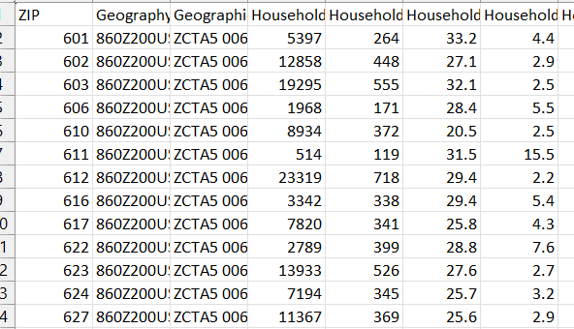
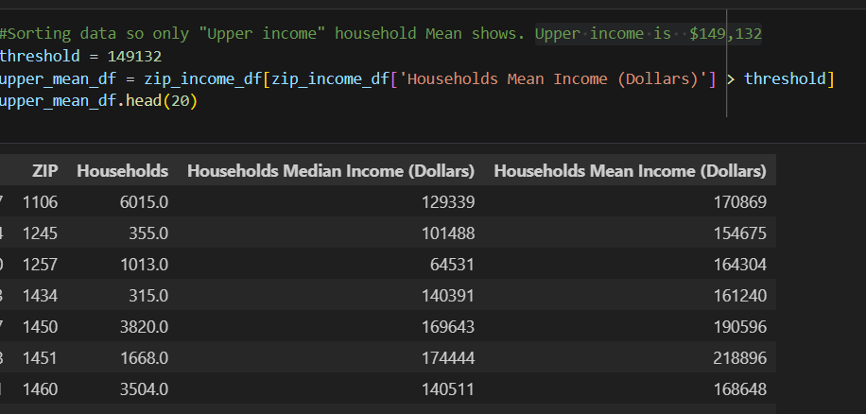
From 343,940 lines of data with 111 columns!
Household income by zip code.
Sorted DF with only relevant data
Analysis steps
Import panda – read csv – create df with only relevant columns
drop empty rows – identify data types & make adjustments
initial analysis including number of rows max & minimum
sorting data by Median & Mean – create new df with only “Upper Income”

Slide 7
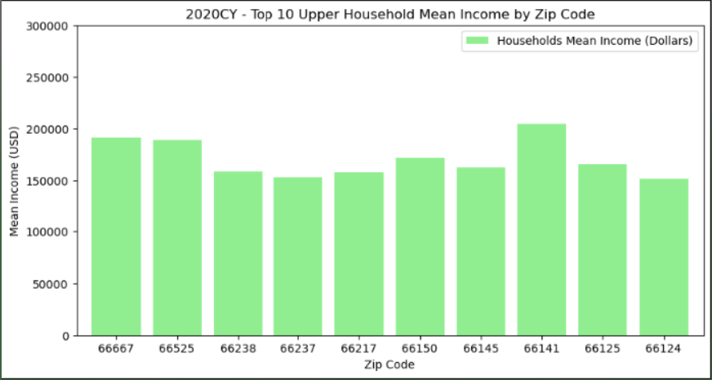
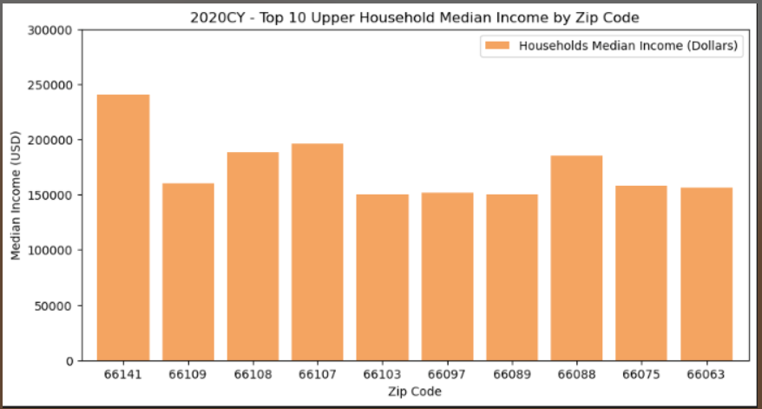

Mean vs median – what’s the best measure?
Same year and “same” measure – the wider the gap between high and low income households, the more varied the data.

Slide 8
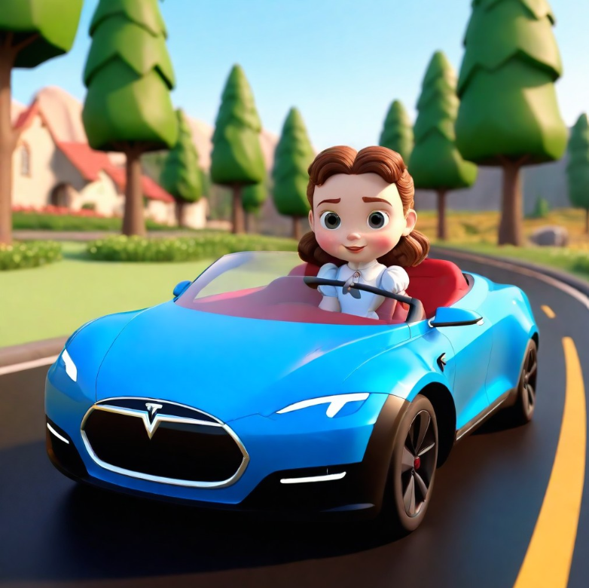
Could this be the reality in Kansas?
*AI GENERATED IMAGE

Slide 9
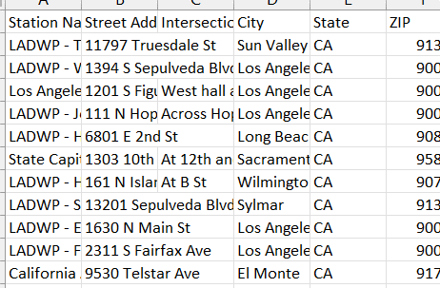
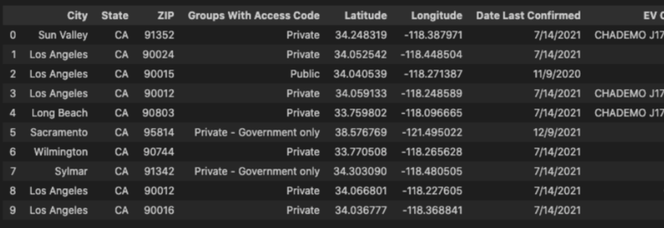
From 50,290 lines of data with 63 columns!
Locations of EV Chargers by zip code.
Sorted DF with only relevant data
Analysis steps
Import panda – read csv – create df with only relevant columns
drop empty rows – identify data types & make adjustments
Decided which types of chargers we will analyze (J1772 & public access)
rename columns – Eliminate unnecessary columns

Slide 10
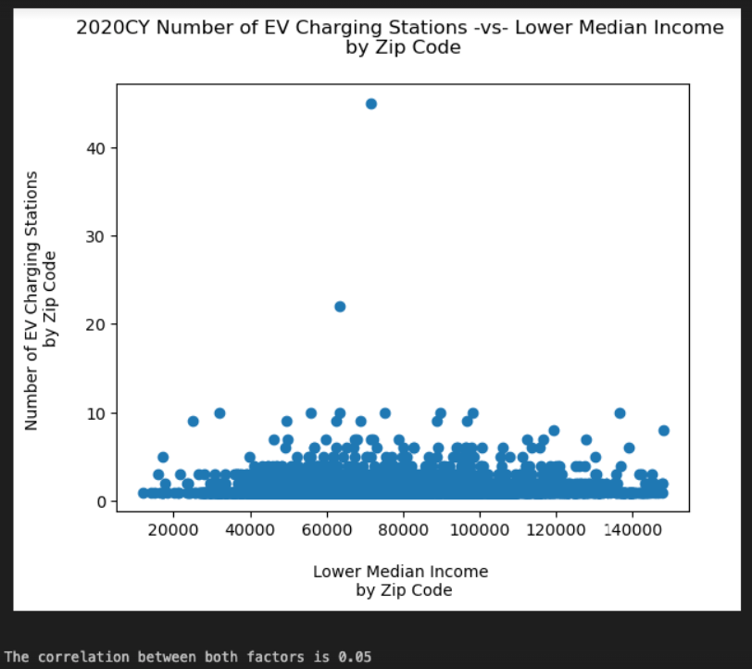
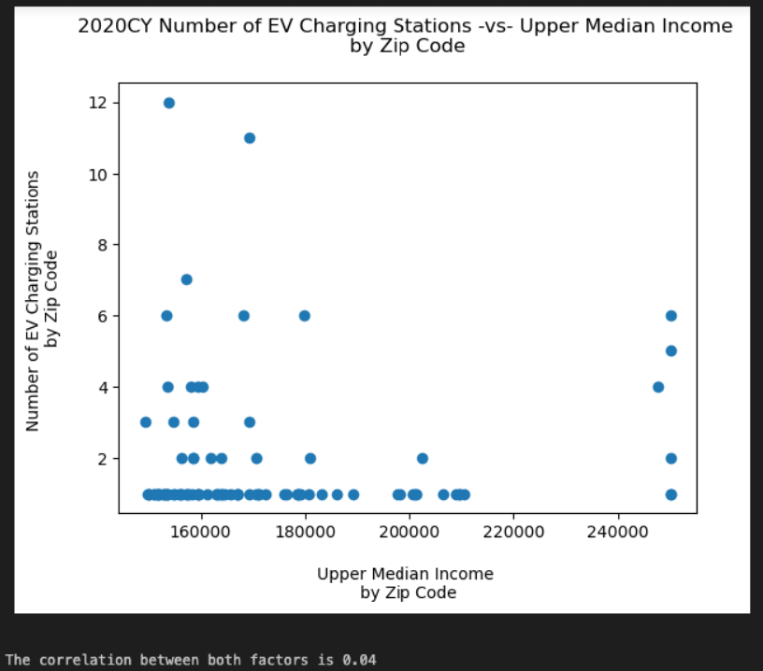
Number of EV Chargers in the USA 2020

Slide 11
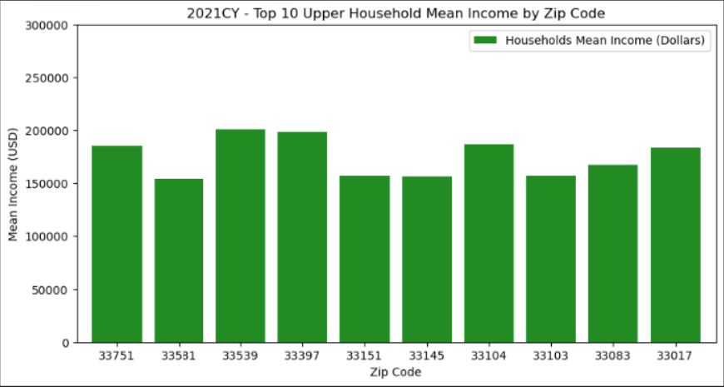
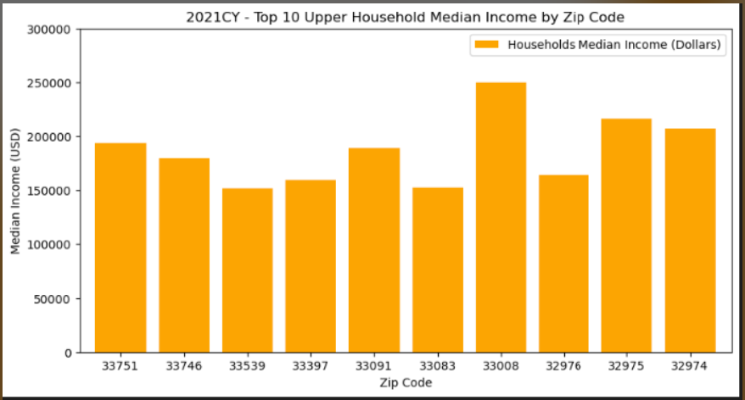
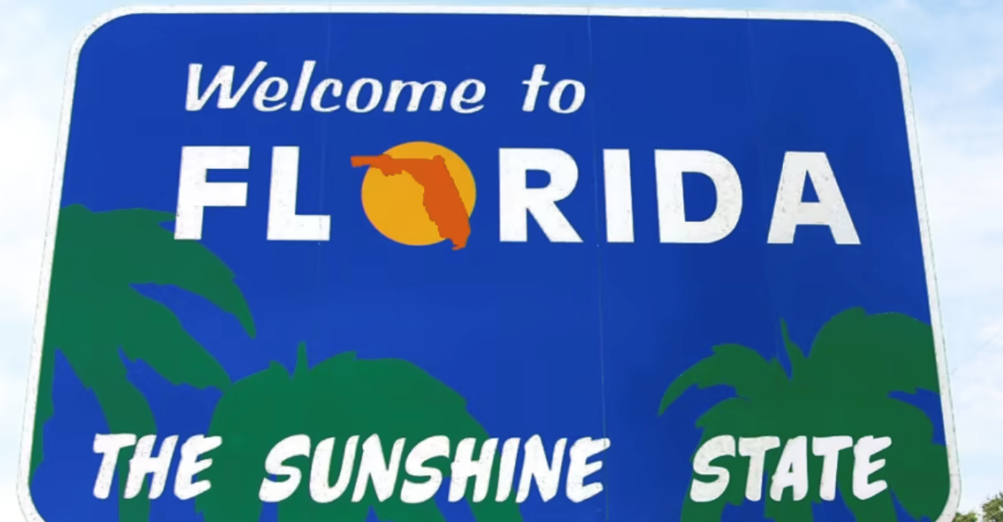
What’s the story in 2021?

Slide 12
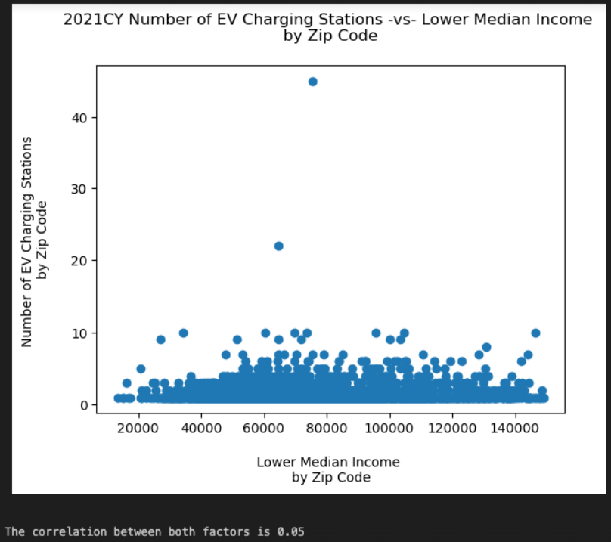
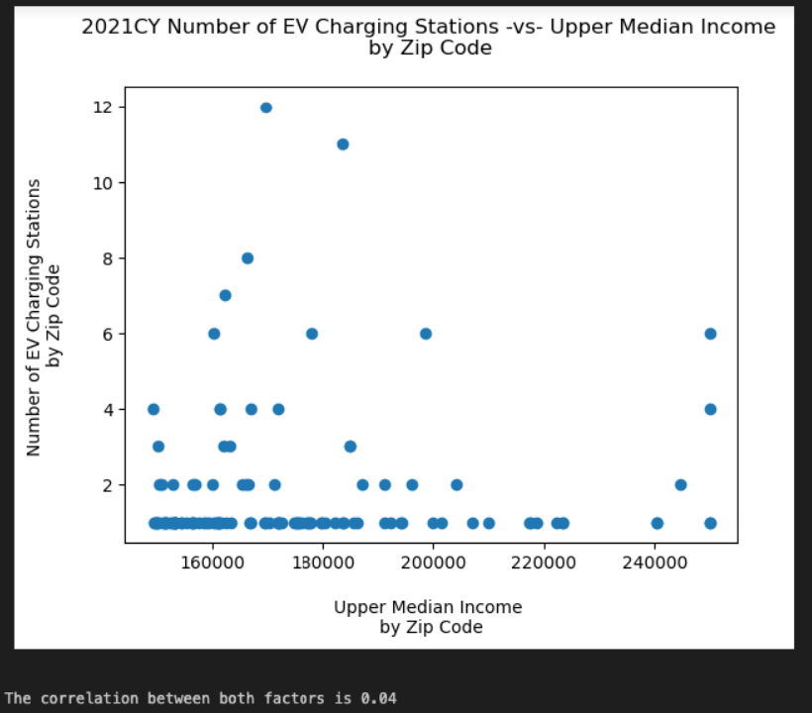
Number of EV Chargers in the USA 2021

Slide 13
Additional notes….
14,781 public access J1772 chargers available
Private (home & government) chargers not included
Need to identify facility most likely to have a charger
Additional analysis needed to determine number of chargers per location (facility type)

Slide 14
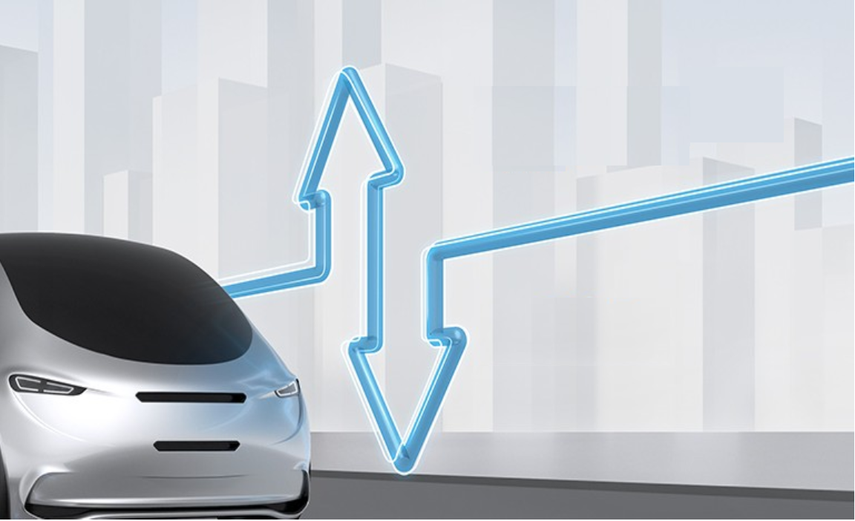
Would YOU drive an electric vehicle?
Click the “raise hand” to say YES!

Slide 15
3. Conclusion
Our analysis (the Pearson correlation coefficient) showed a .04 coefficient – or that there is little to no correlation between accessibility of EV chargers compared to “Higher Income” (over $150K) zip codes in a state.
This statement also holds true to “Lower Income” (less than $150K) zip codes as that coefficient was .05.
Trends are both the same in 2021 and 2020.

Slide 16

Thank you

